Slide 1
Verified Timestamping
Computer Security Division
Secure Systems and Applications Group
By Temur Saidkhodjaev
Mentors: Jeff Voas, Rick Kuhn

Slide 2
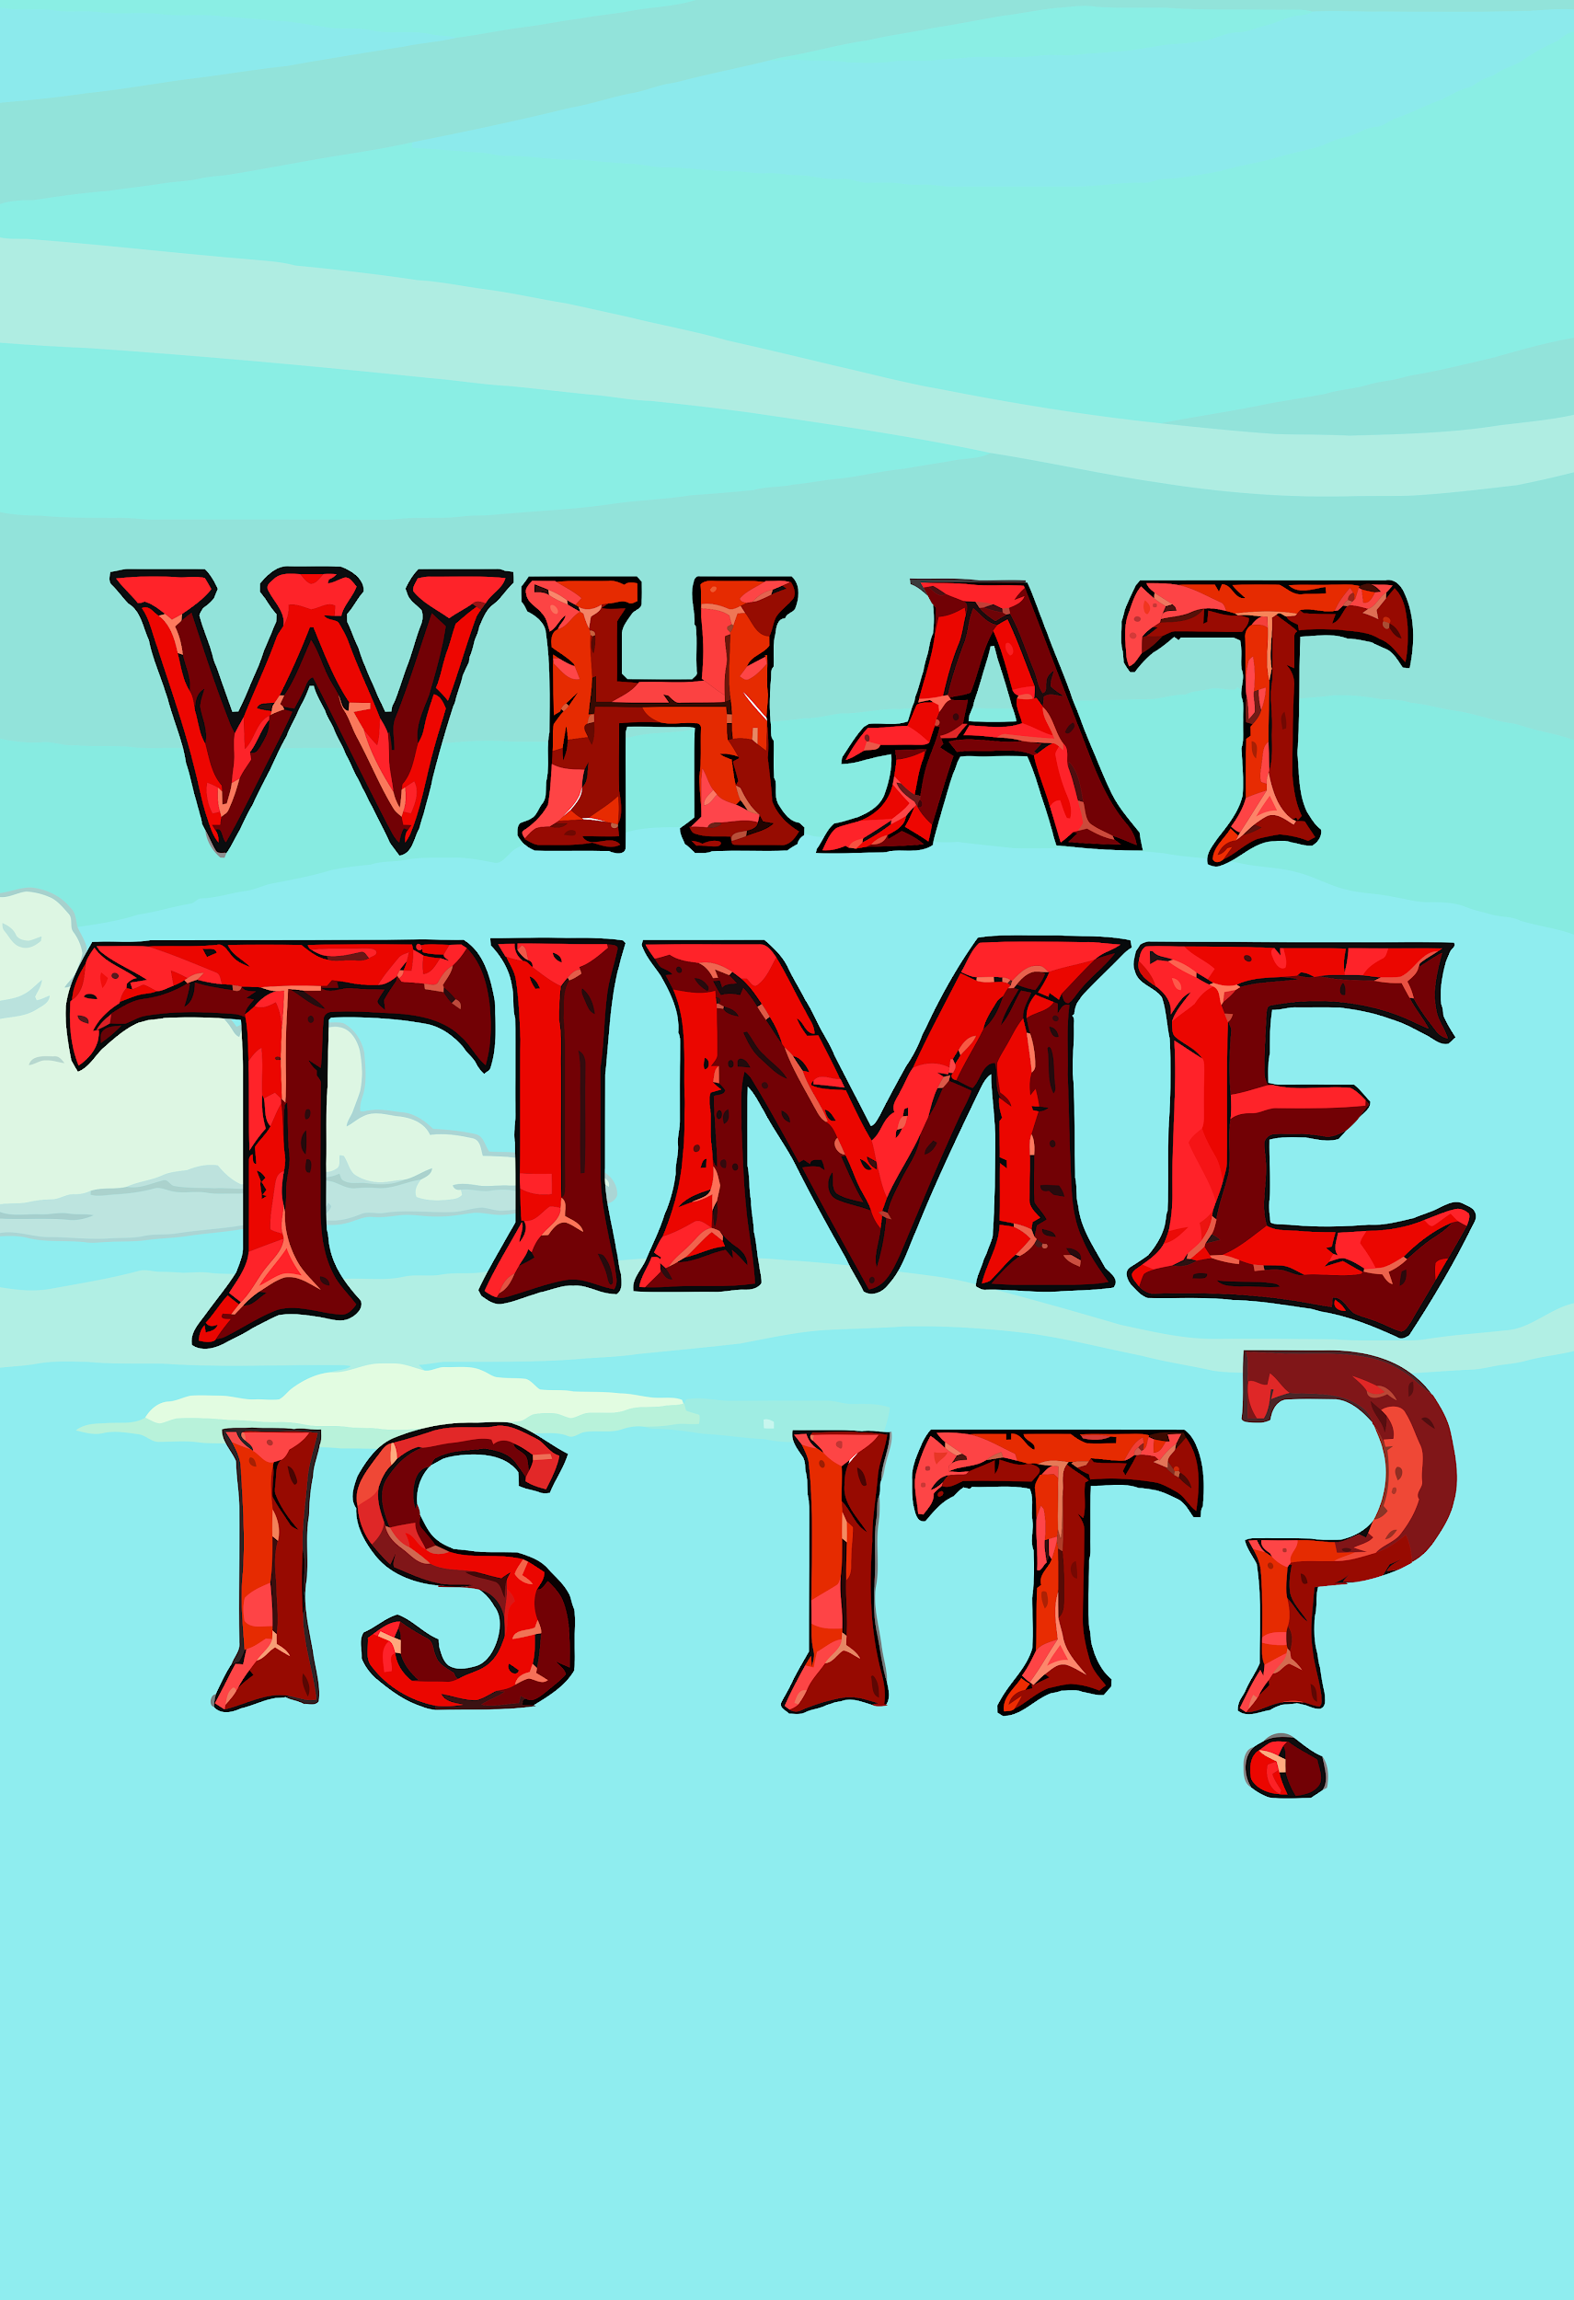

Slide 4
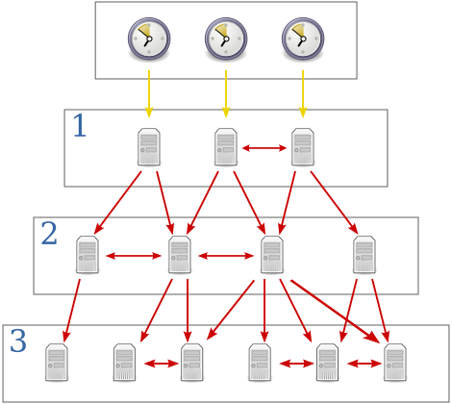
Network Time Protocol (NTP)

Slide 5
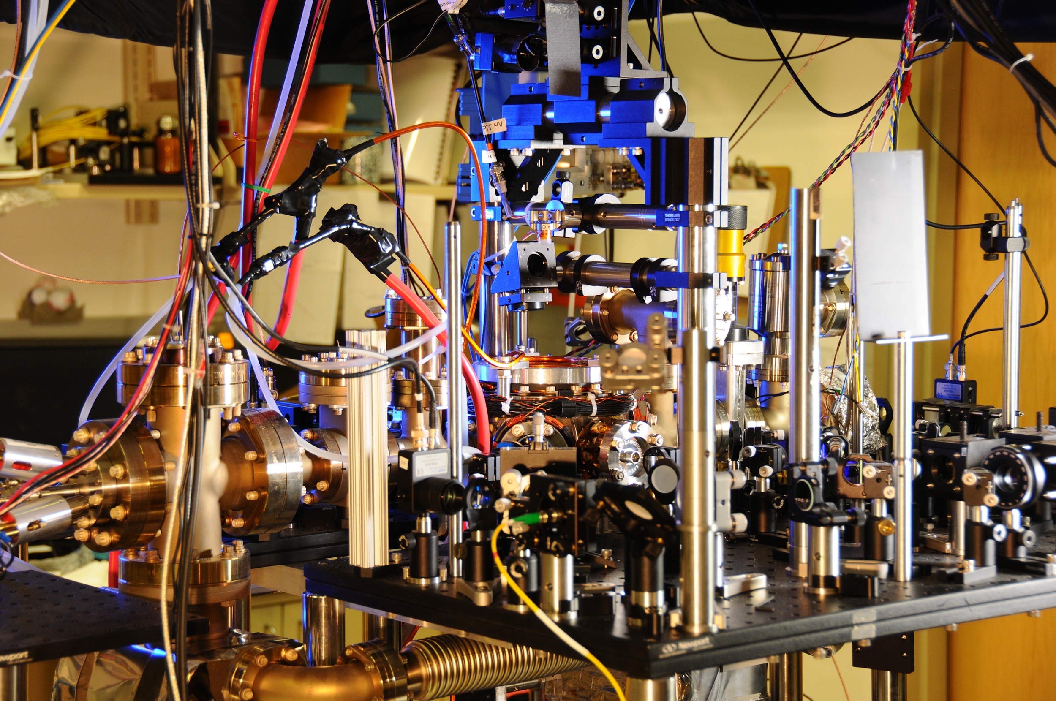
Atomic Clocks

Slide 6
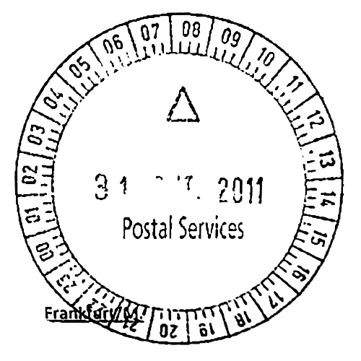
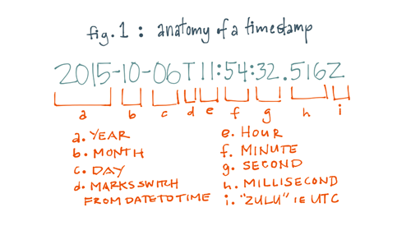
Timestamping

Slide 7
Order Preservation
 | Event 1 | Event 2
Real timestamp | 100 | 101
Acceptable timestamp | 100 | 100
Wrong timestamp | 101 | 100

Slide 8
Timestamping Authority (TsA)

Slide 9
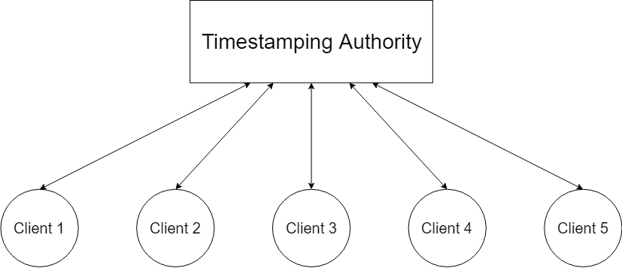
Single TsA?

Slide 10
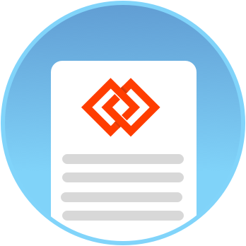
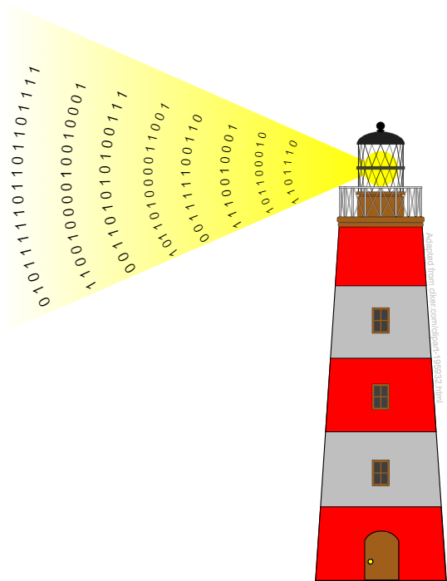
Chainpoint
Chainpoint.org
NIST Randomness Beacon
Blockchain
$$Chainpoint Proof: \left(Timestamp+hash(purely random bits)\right)→Blockchain$$

Slide 11
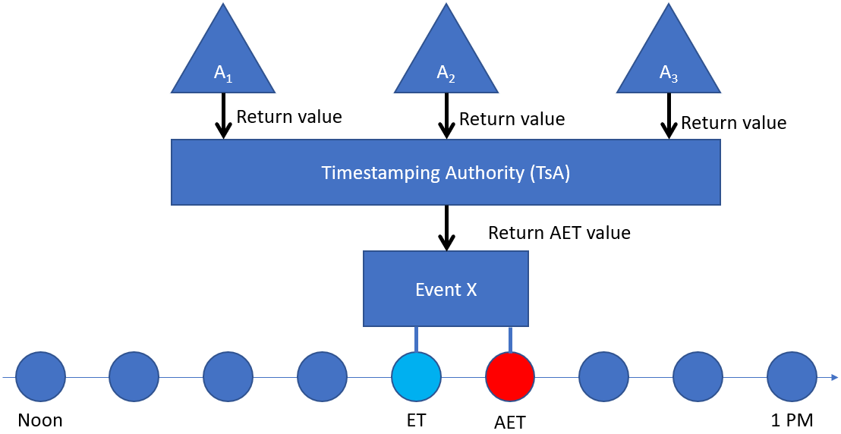
Atomic Clock Aggregation

Slide 12
Client-server Timings
Client
Server
Local time offset calculation

Slide 13
Over 400 atomic clocks around the world are used in calculation of Universal Coordinated Time (UTC)
International Bureau of Weights and Measures

Slide 14
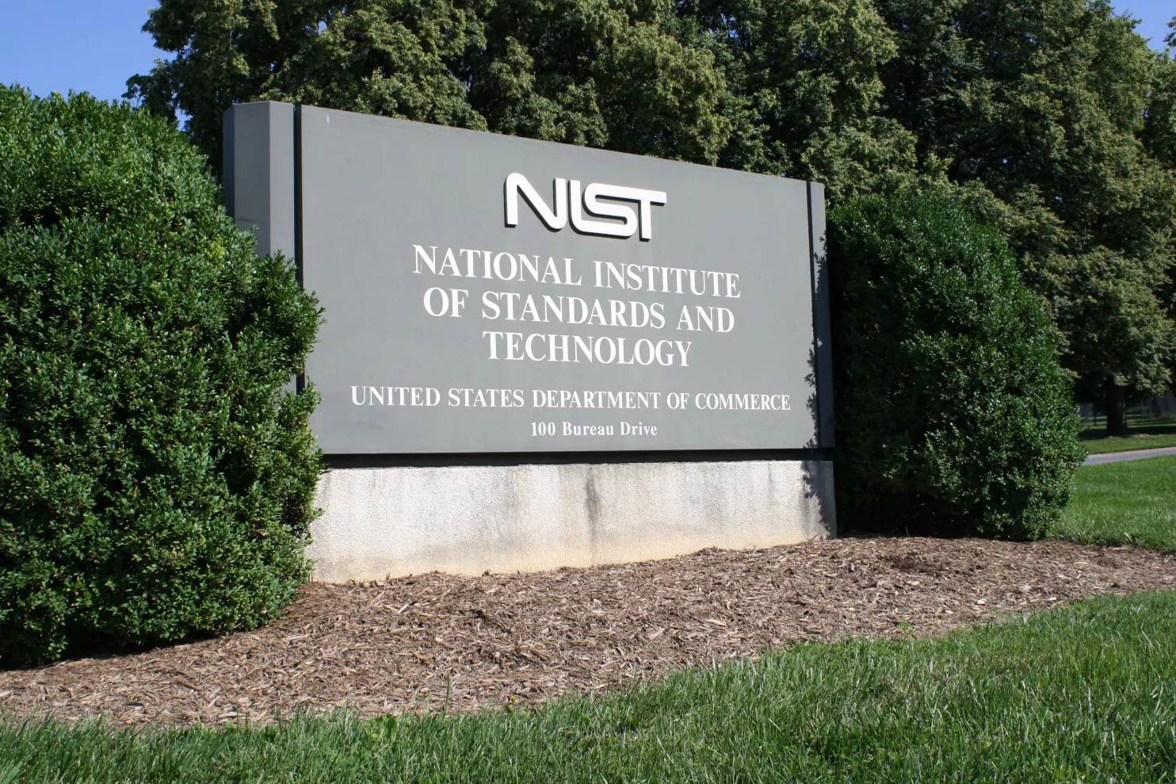
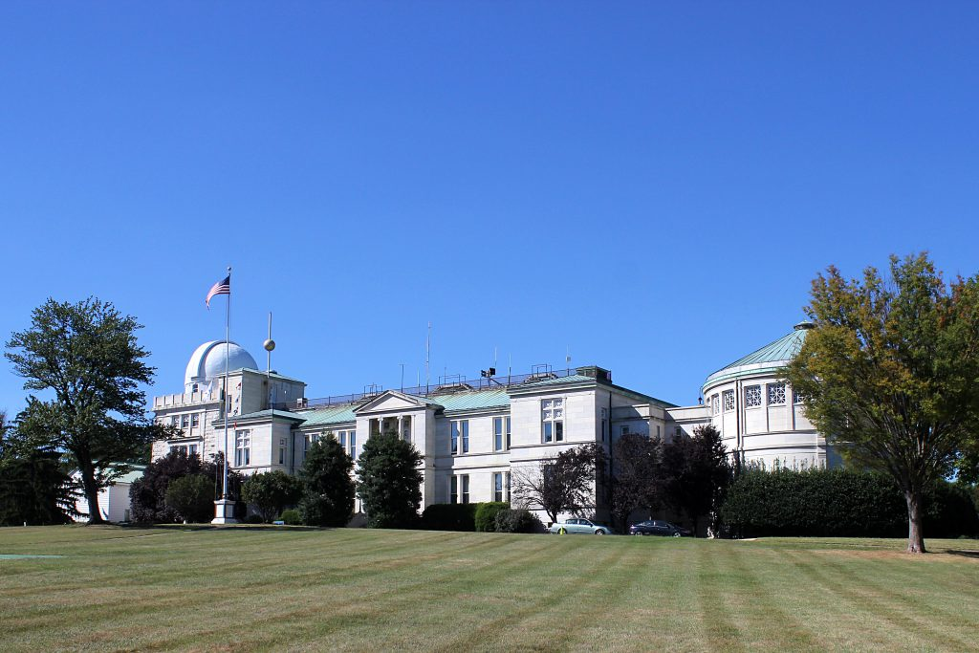
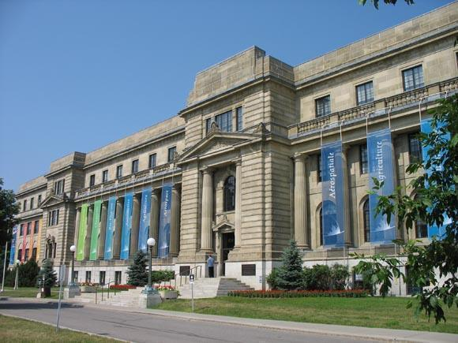
Clocks Used
NIST, Gaithersburg, USA
US Naval Observatory, Washington, DC, USA
National Research Council, Ottawa, Canada

Slide 15
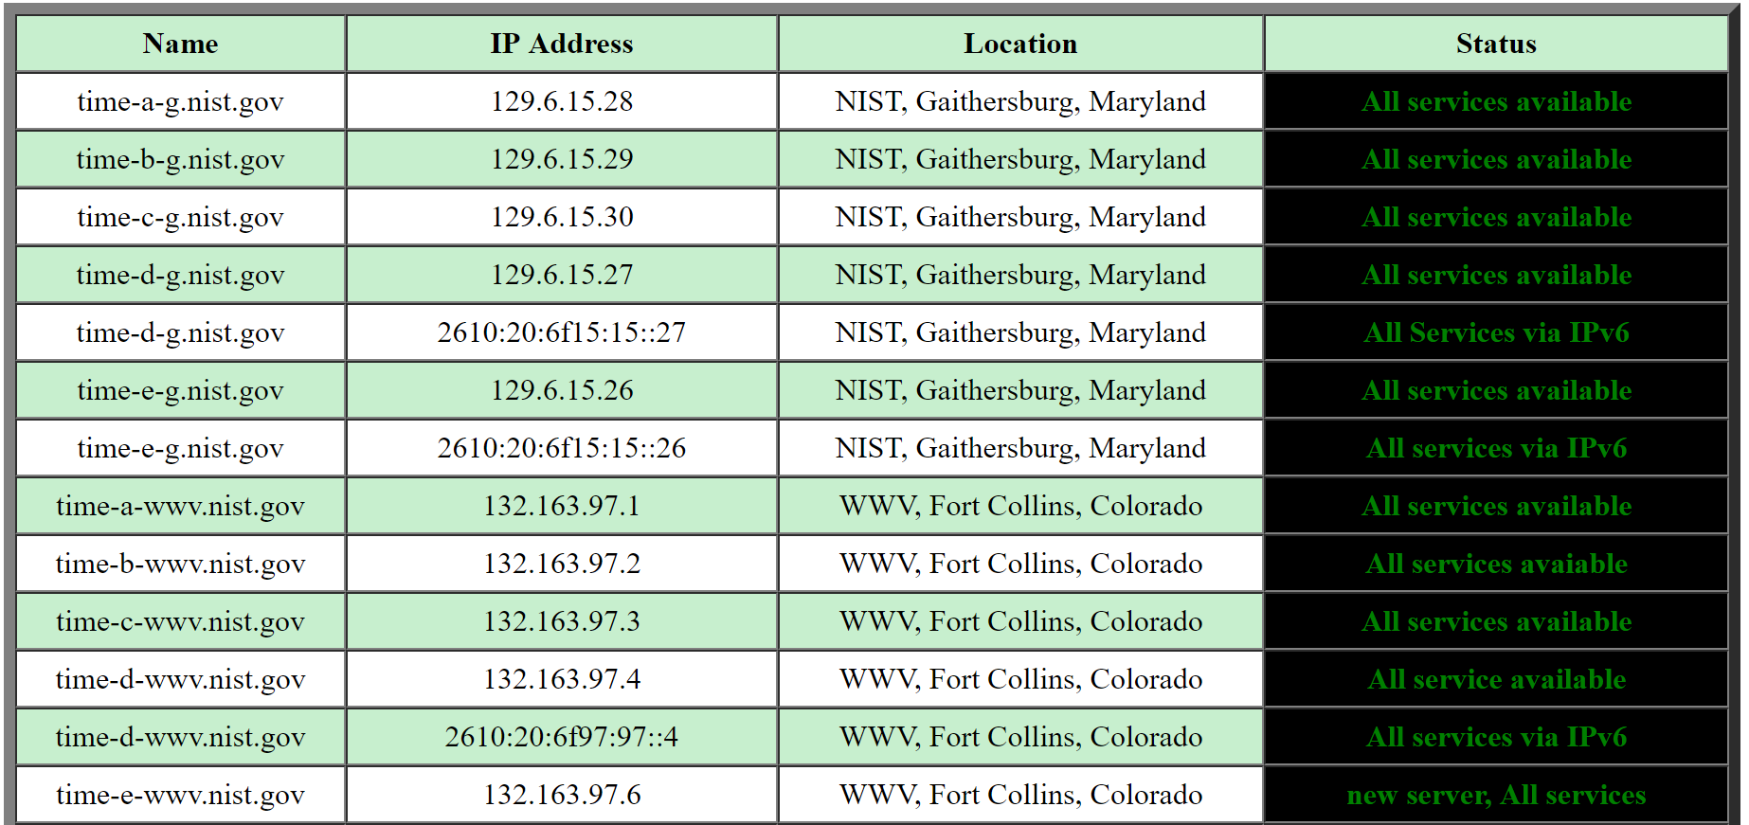
Implementation Description
Public NTP servers available
Code in Java
Update every 10 seconds

Slide 17
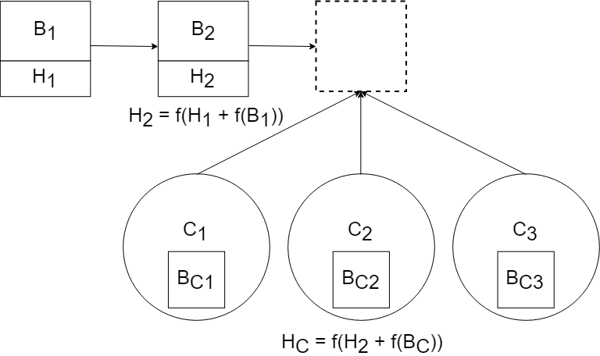
Application to Blockchain (Before)
The winner goes in
Others have to recalculate

Slide 18
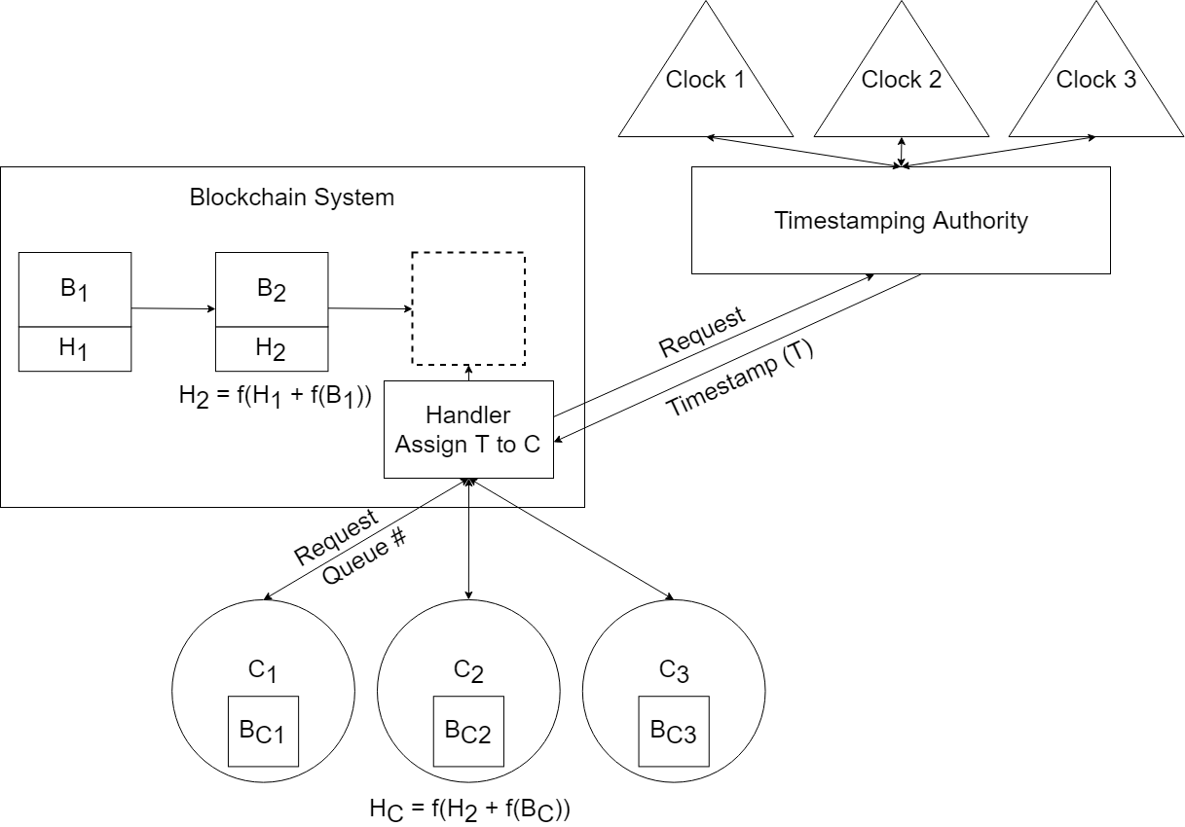
Application to Blockchain (After)
Each client is assigned a Queue #
First in the queue gets some time to finish the calculation
Others don’t waste resources

Slide 19
Acknowledgements
NIST SURF Program Directors
Brandi Toliver
My mentors Jeff Voas and Rick Kuhn
Fellow SURFers!

Slide 20
Thank you!

Slide 21
Bibliography
Kuhn, Rick, et al. “Rethinking Distributed Ledger Technology.” Computer (00189162), vol. 52, no. 2, Feb. 2019, pp. 68–72. EBSCOhost, doi:10.1109/MC.2019.2898162.
Kuhn, R. “A Data Structure for Integrity Protection with Erasure Capability.” National Institute of Standards and Technology, May 2018. https://csrc.nist.gov/publications/detail/white-paper/2018/05/31/data-structure-for-integrity-protection-with-erasure-capability/draft.
Stavrou, Angelos, and Jeffrey Voas. “Verified Time.” Computer, no. 3, 2017, p. 78. EBSCOhost, search.ebscohost.com/login.aspx?direct=true&db=edsgao&AN=edsgcl.495522688&site=eds-live&scope=site.
Time Annual Report on Time Activities. BIPM, Volume 12, 2017, Cedex, France. https://www.bipm.org/utils/en/pdf/time_ann_rep/Time_annual_report_2017.pdf.
Mills, D. L. “Network Time Protocol (Version 3) Specification, Implementation and Analysis”. University of Delaware, Network Working Group, March 1992, RFC 1305. https://tools.ietf.org/html/rfc1305.
Lombardi, M. “Computer Time Synchronization.” National Institute of Standards and Technology, Time and Frequency Division. https://tf.nist.gov/service/pdf/computertime.pdf.

Slide 22
Pictures
https://www.deviantart.com/purpletinker/art/What-Time-Is-It-Adventure-Time-poster-494404504
https://en.wikipedia.org/wiki/File:JaketheDog.png
https://commons.wikimedia.org/wiki/File:Network_Time_Protocol_servers_and_clients.svg
https://www.rawpixel.com/image/39353/running-late-for-class
https://www.nist.gov/news-events/news/2013/08/nist-ytterbium-atomic-clocks-set-record-stability
https://commons.wikimedia.org/wiki/File:Timestamp.png
https://mode.com/blog/date-trunc-sql-timestamp-function-count-on
https://all-free-download.com/free-icon/download/tick-ok-sign_4190.html
https://all-free-download.com/free-icon/download/sign-error_98030.html
https://chainpoint.org/
https://www.kisspng.com/png-plus-and-minus-signs-computer-icons-clip-art-plus-566321/
https://csrc.nist.gov/projects/interoperable-randomness-beacons
https://www.shutterstock.com/image-vector/blockchain-logo-template-technology-vector-design-1125067880
https://www.bipm.org/en/about-us/
https://twitter.com/USNHistory/status/1046739005512052737
http://wikimapia.org/27368/Sussex-Laboratories-National-Research-Council-of-Canada#/photo/449697
https://tf.nist.gov/tf-cgi/servers.cgi

